Slide 1
Order of Operations
Integrated mathematics

Slide 2
Objectives
Students will apply the rules of the order of operations in order evaluate variable expressions.

Slide 3
“Please Excuse My Dear Aunt Sally” or PEMDAS.
Order of Operations
Parentheses - ( ) or [ ]
Exponents or Powers
Multiply and Divide (from left to right)
Add and Subtract (from left to right)

Slide 4
Evaluate 7 + 4 ● 3
Is your answer 33 or 19?
You can get 2 different answers depending on what you did first. We want everyone to get the same answer so we must follow the order of operations.

Slide 5
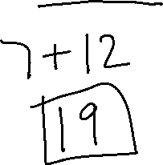
PEMDAS
Ex. 1) 7 + 4 • 3

Slide 6
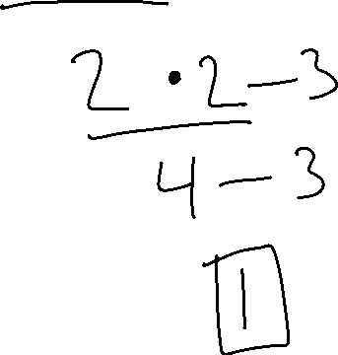
PEMDAS
Ex. 2) 14 ÷ 7 • 2 - 3

Slide 7
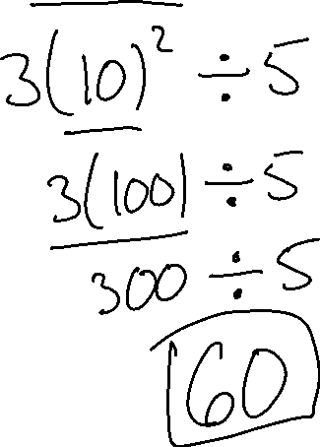
PEMDAS
Ex. 3) 3(3 + 7) ² ÷ 5

Slide 8
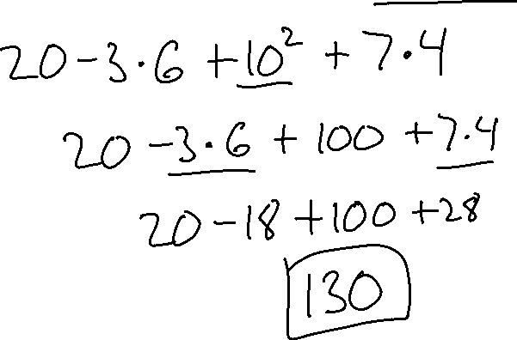
PEMDAS
Ex. 4) 20 - 3 • 6 + 10² + (6 + 1) • 4

Slide 9
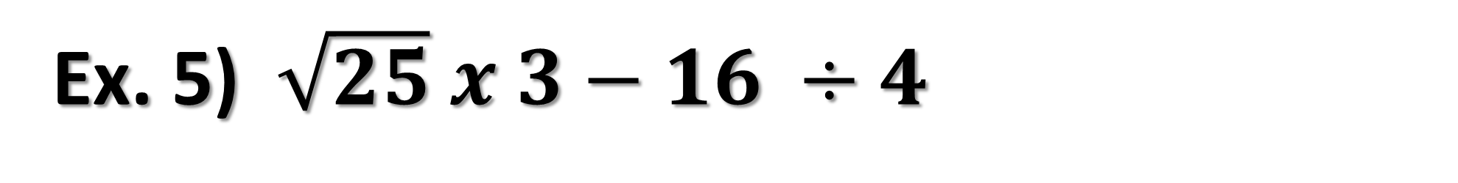
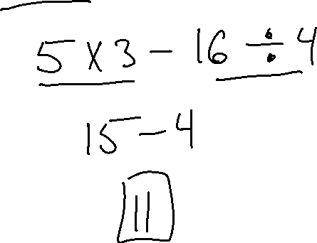
PEMDAS
Ex. 5) $\sqrt{25} x 3−16 ÷4$

Slide 10
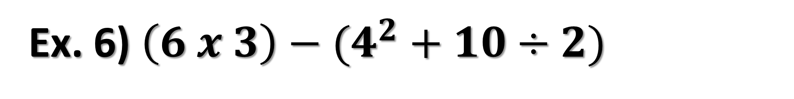
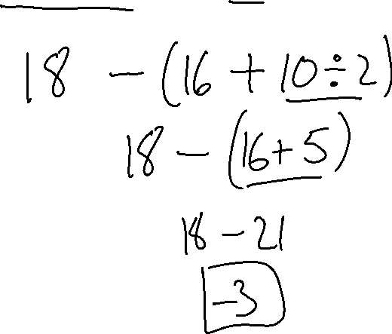
PEMDAS
Ex. 6) $\left(6 x 3\right)−(4^{2}+10÷2)$

Slide 11
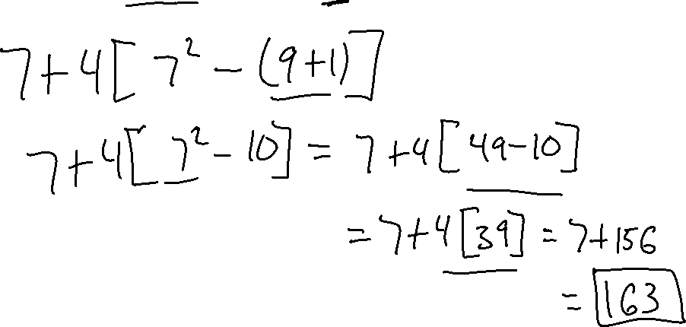
PEMDAS
Ex. 7) 7 + 4[(4 + 3)² - (3² + 1)]

Slide 12
TRY THESE
11² + 18 - 3³ · 5
16 - 2(10 - 3)
24 – 6 · 4 ÷ 2

Slide 13
Evaluate A VARIABLE EXPRESSION
To Evaluate a Variable Expression:
  Plug in the numbers for each variable
  Use order of operations to solve

Slide 14
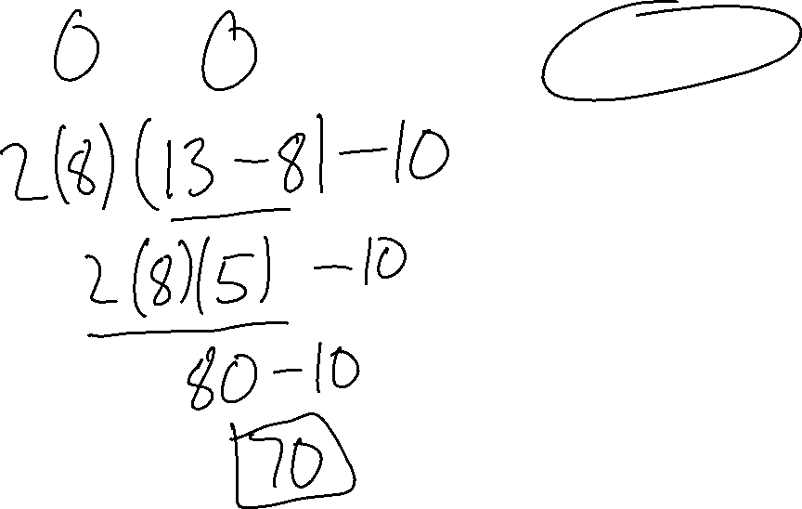
Variable Expressions
Ex.8) 2n(13 - n) - 10 for n = 8

Slide 15
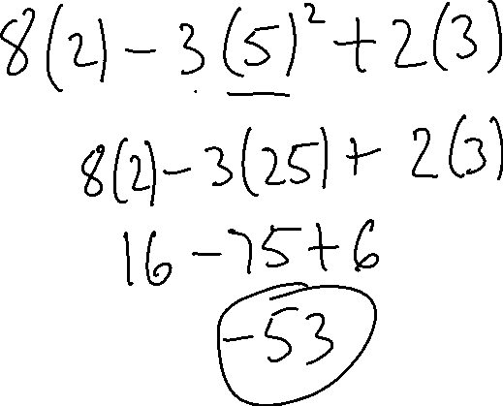
Variable Expressions
Ex.9) 8y - 3x² + 2n for x = 5, y = 2, n = 3

Slide 16
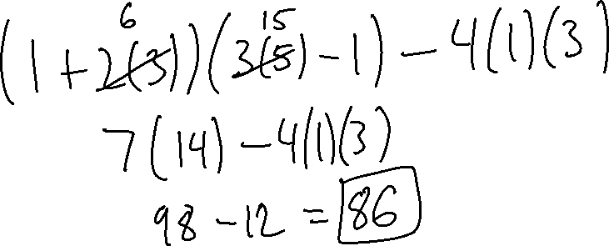
Variable Expressions
Ex.10) a = 1, b = 3, c = 5
(a + 2b)(bc – a) – 4ab

Slide 17
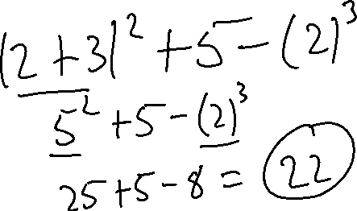
Variable Expressions
Ex.11) a = 2, b = 3, c = 2
(a + b)² + 5 - c³

Slide 18
Try These
5k³ if k = -4
n = -8, m = 4, and t = 2

